Slide 1
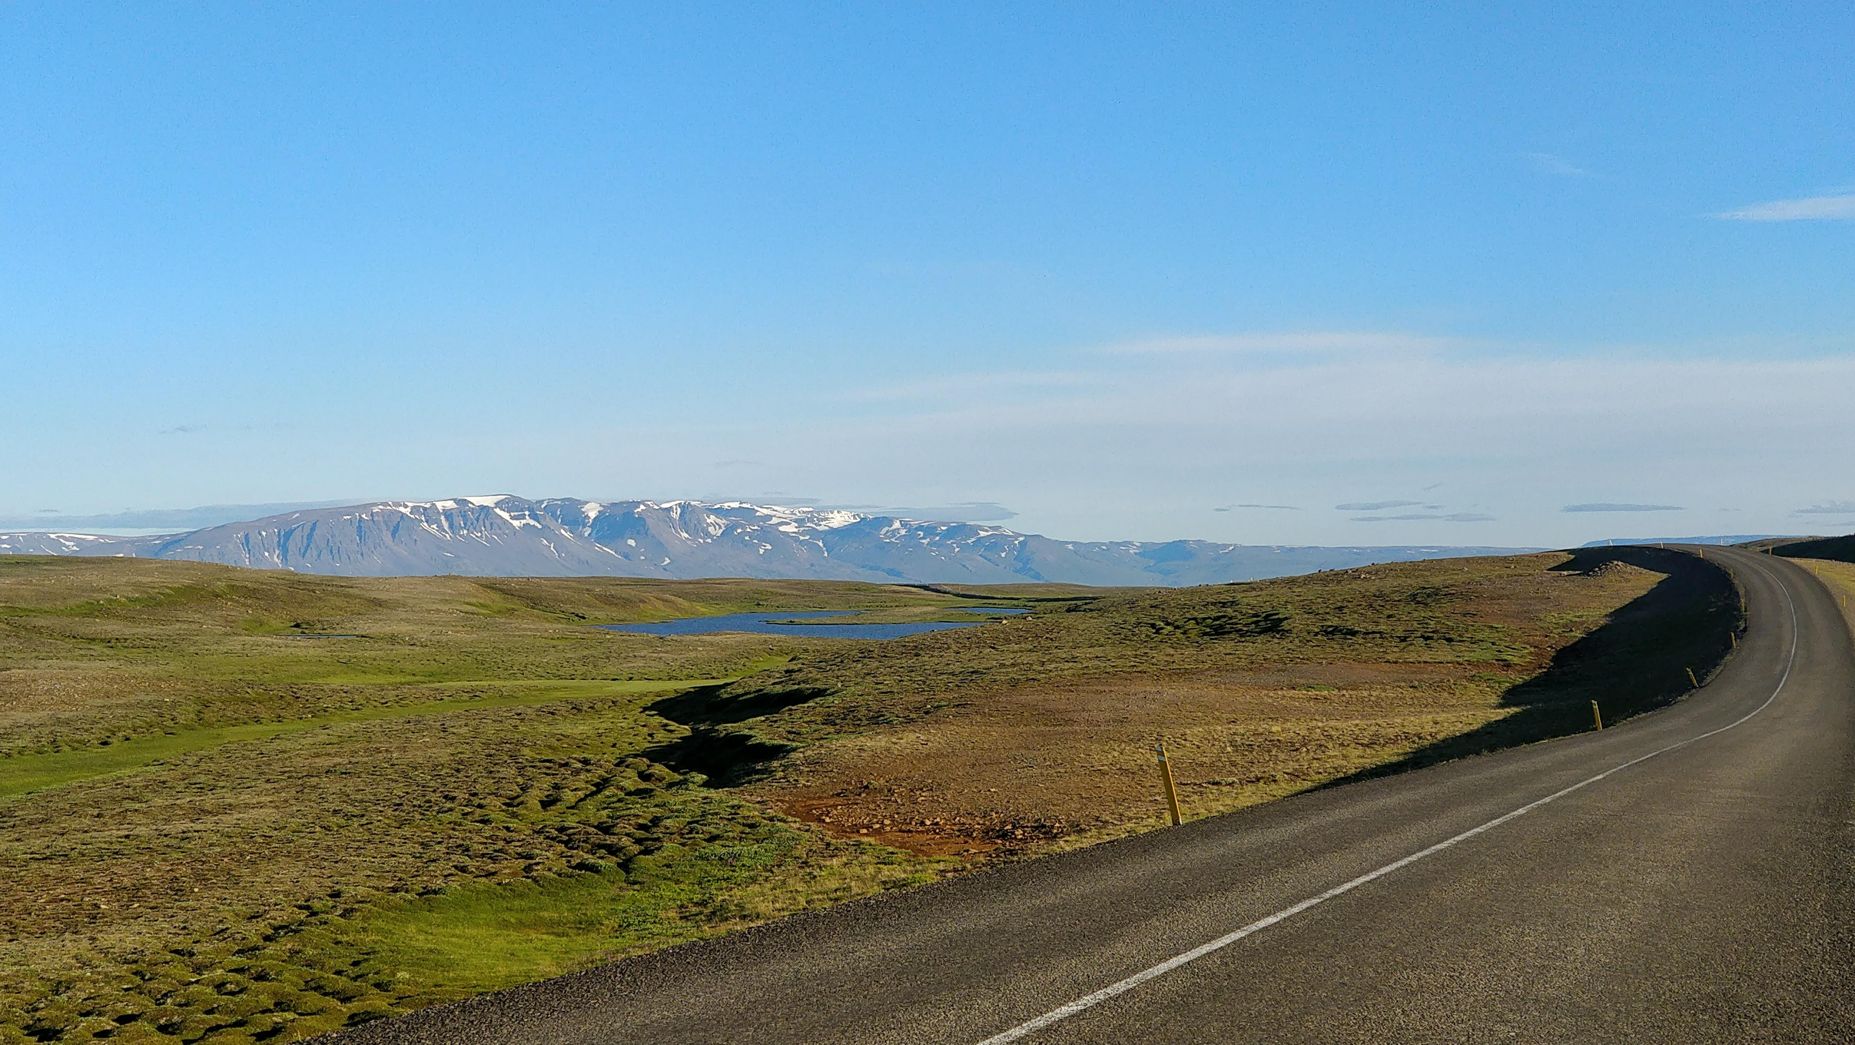
In Love with Tourist Destination Brand
Dr. Nivedita Sharma
Email – niveditasharmars@gmail.com

Slide 2
Agenda
Motivation
Tourist destination brand
Falling in love with tourist destination brand
Falling in love online
Conclusion
Love for a destination
Use of technology (28% increase in travel #recommending tweets; 46% #destionation - Twitter)
Lock-down conditions (world tourist arrivals from -70% in 2021 to -43% in 2022 – UNWTO)

Slide 3
Tourist Destination Brand
Destinations attract potential tourists by evoking emotions (Hudson and Ritchie 2009).
Tourists also display emotions towards destination brands (Vada et al 2019, Brakus et al 2009).
Emotions are based on perceived self-image and destination brand personality (Murphy and Moscardo 2007).
Emotions of joy and love have positive relationships with perceived overall image of the destination (Prayag et al 2015).

Slide 4
Emotions like pleasure, amazement, caring and inspiration were found to be meaningful for place attachment and experience (Hosany et al 2016).
Place attachment could be formed with first time or repeat tourists having memorable experience (Vada et al 2019).
Tourists who have long brand history and first time visitor both can fall in love with the brand (Aro et al 2018).
A study found that respondents displayed emotional bonding with an unknown destination looking at imaginary pictures (Cheng and Kou 2015).

Slide 5
Tourist
Destination
Perceived self-image
Visit
First time or repeat
Destination love
Experience
Emotions

Slide 6
Falling in love
Removing physical presence really helps in enhancing love by creating a more intimate connection between them as they really (Briggle 2008).
Those who reported love at first sight have stronger romantic relationship with their partners (Zousk et al 2017).
Love at first sight could take form of human relationships with greater passion, intensity and self-identification (Palusuk et al 2019).

Slide 7
Tourist destination
Perceived self-image
Novelty
Sensory stimulation
Destination Love
Brand uniqueness (functional, sensory and communicative) – is a stimulus to fall in love (Rahman et al JBM 2021).
Diţoiu et al (2014) studied the use of sensory elements (visual, auditory, olfactory, gustatory, and tactile) in developing the marketing strategies for a tourist destination.
Novelty in stimulation and excitement need results in high brand romance (Patwardhan and Balasubramanian 2013).
P1 – Tourists’ can fall in love with a unique (sensory stimulating) destination brand without visiting.

Slide 8
Falling in love online
Social media marketing influences brand romance by building emotional bonds with the brand; even in tourism context (Being and Khan 2019, Xiang and Gretzel 2010, Fatanti and Suyadnya 2015, Park et al 2016).
Self-expressiveness in content when a place message supports and enacts consumers self-concept would result in brand love (Strandberg and Styven 2018).
Social identity with the social groups online will have positive influence on brand love (Vernuccio et al 2015).

Slide 9
Tourist destination
Perceived self-image
Online Engagement
Aesthetic
Social identity
Destination Love
Online brand involvement results in positive emotions (Loureiro et al 2017).
Aesthetics (fascinating and pleasing website) have important significant impact on destination emotional experience (pleasurable and exciting), Zhang et al 201.
For hedonic consumption the unconscious and conscious level of arousal generate higher pleasure (Battiga et al 2020). Tourists hedonic happiness is fundamental for destination attachment (Lee and Jeong 2021)
P2 a – Tourists’ can fall in love with a destination brand through online engagement with the brand.

Slide 10
Tourist Destination Brand
Online Engagement
Aesthetic
Social identity
Tourist Destination Love
Perceived Self-image
Involvement
Hedonic consumption
Novelty
Sensory stimulation
P2 b– Tourists’ can fall in love with a destination brand online that is unique and integrates self-image.

Slide 11
Synopsis
Study will explore how tourists fall in love with tourist destination brand
The relationship dimensions that that tourist develop with the destination brand without visiting the destination based on novelty of the place.
The effect of online brand engagement on destination brand love.
The extent of perceived self-image and destination novelty will influence the destination brand love.

Slide 12
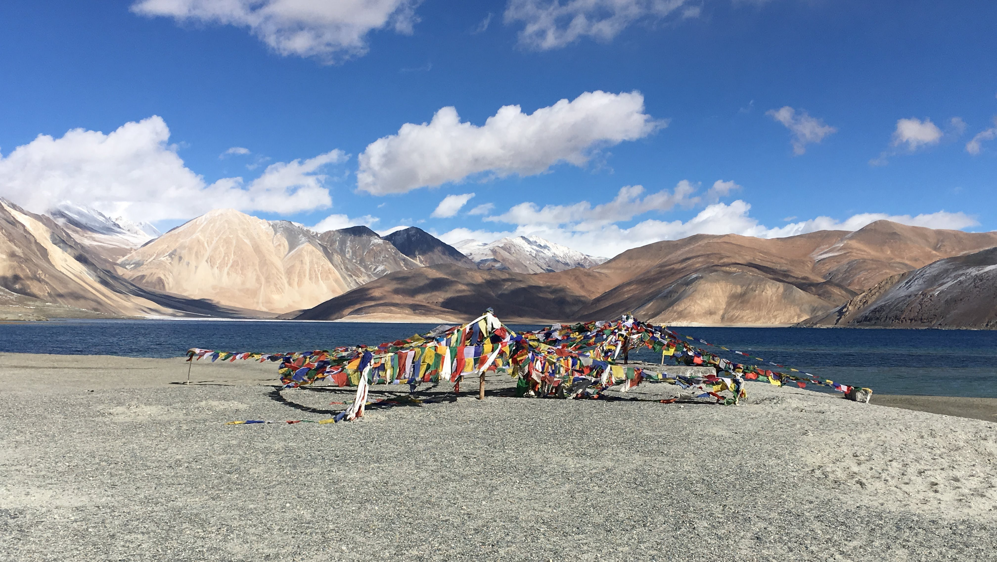
Thank You

